Slide 1
State Tree Identification
Created by Rick, Sarah, Tyler, and Mo

Slide 2
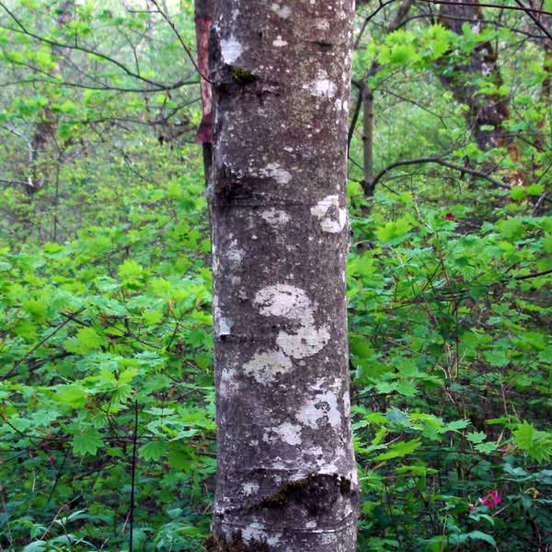

Slide 3
Red Alder
Alnus Rubra

Slide 4
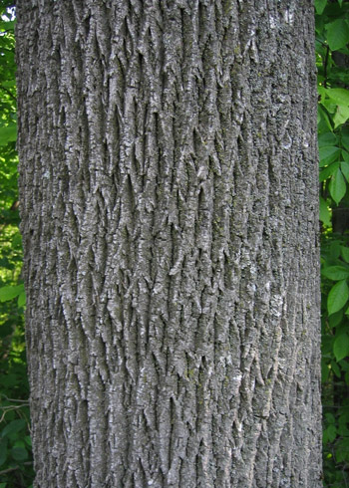
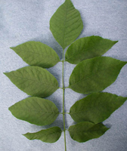

Slide 5
Ash
Fraxinus sp.

Slide 6
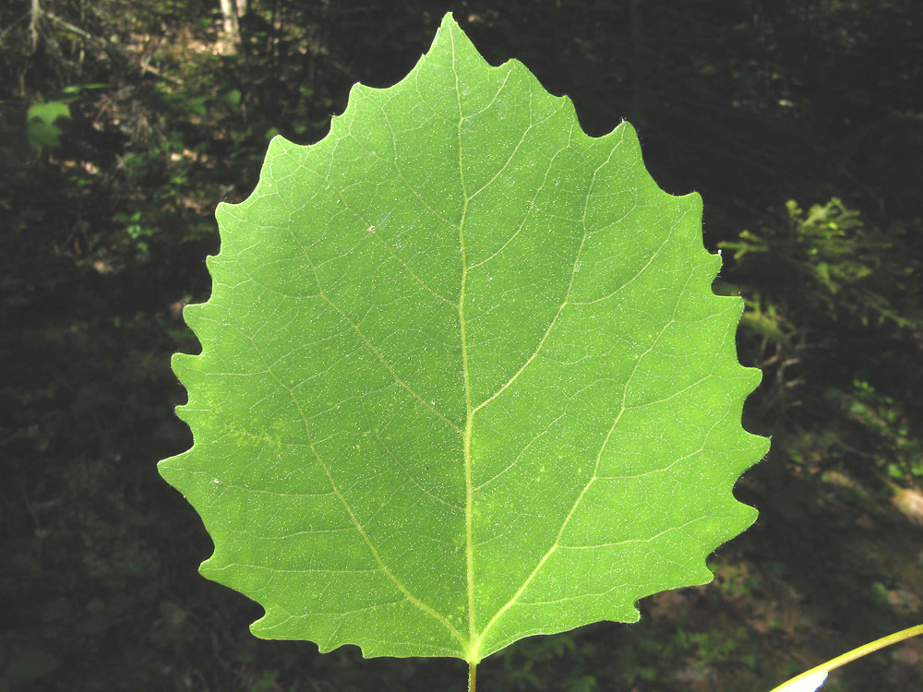

Slide 7
Bigtooth Aspen
Populus Grandidentata

Slide 8
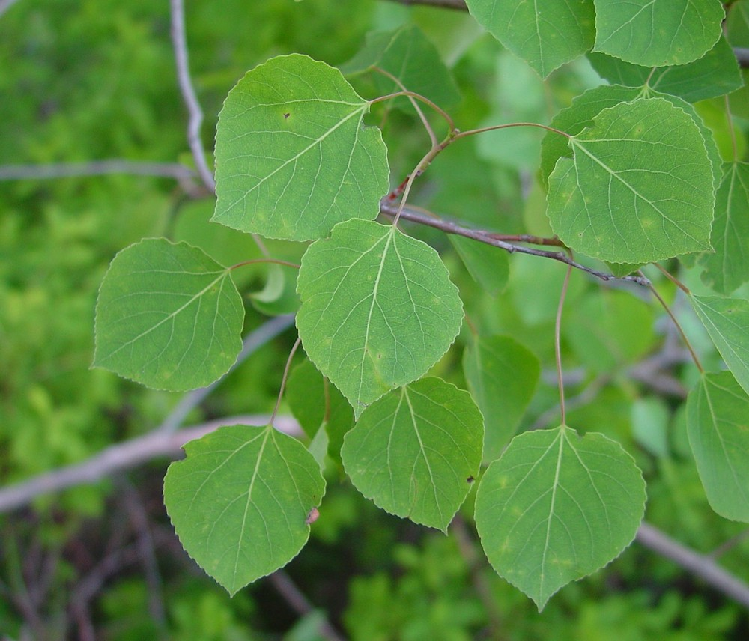
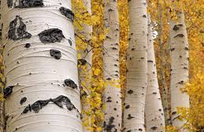

Slide 9
Quaking Aspen
Populus Tremuloides

Slide 10
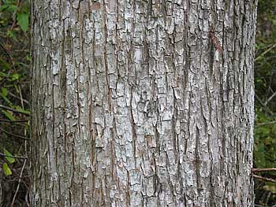
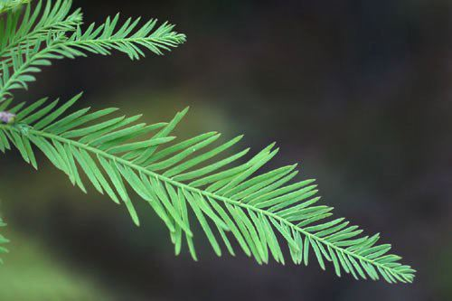

Slide 11
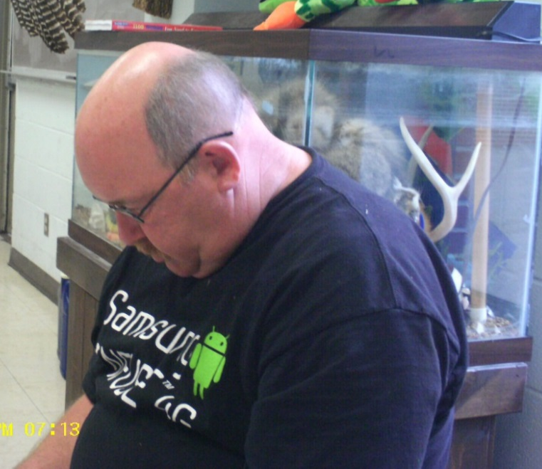
Bald Cypress
Taxodium Distichum

Slide 12
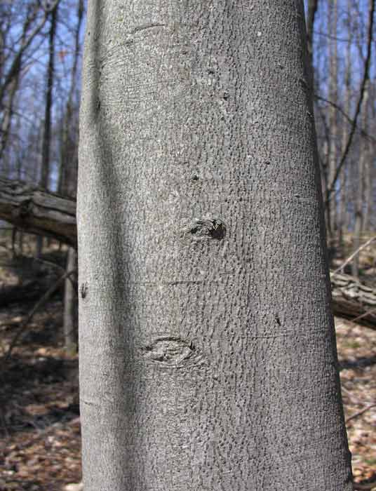
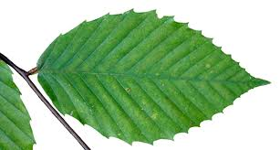

Slide 13
American Beech
Fagus Americana

Slide 14
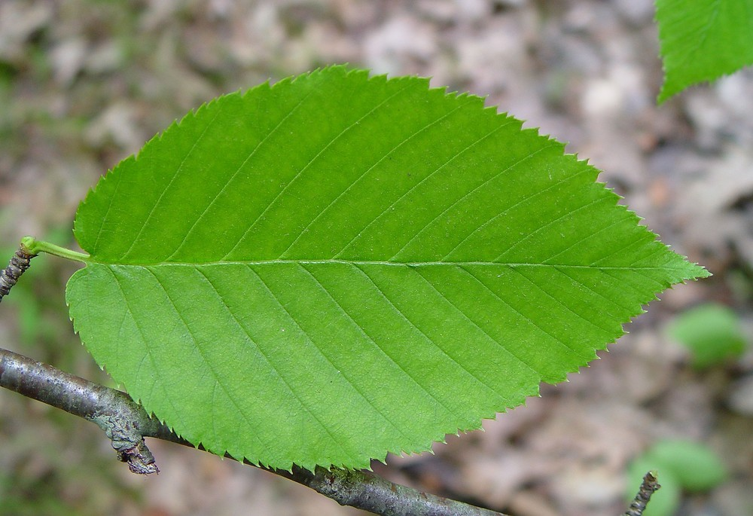
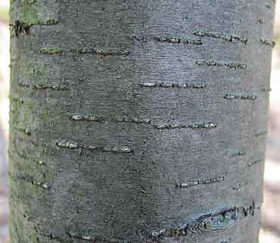

Slide 15
Black Birch
Betula Lenta

Slide 16
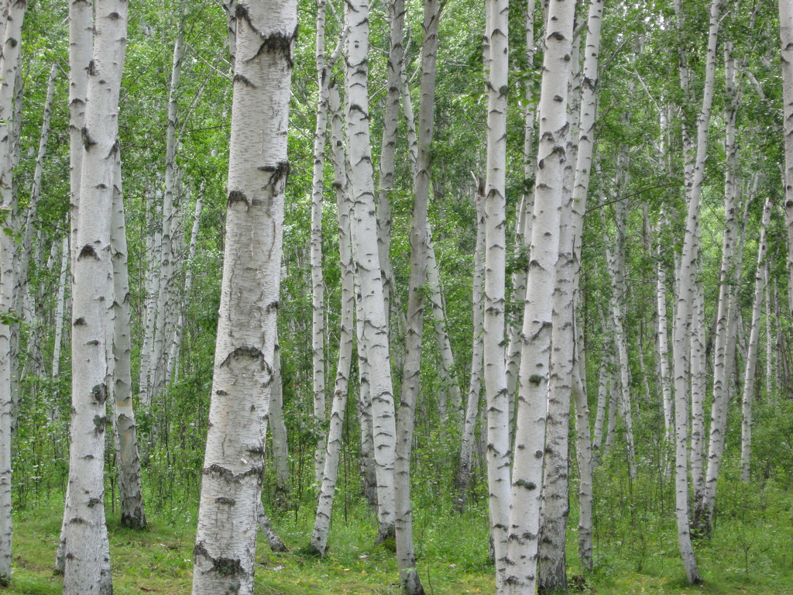
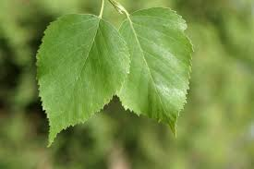

Slide 17
White Birch
Betula Papyrifera

Slide 18
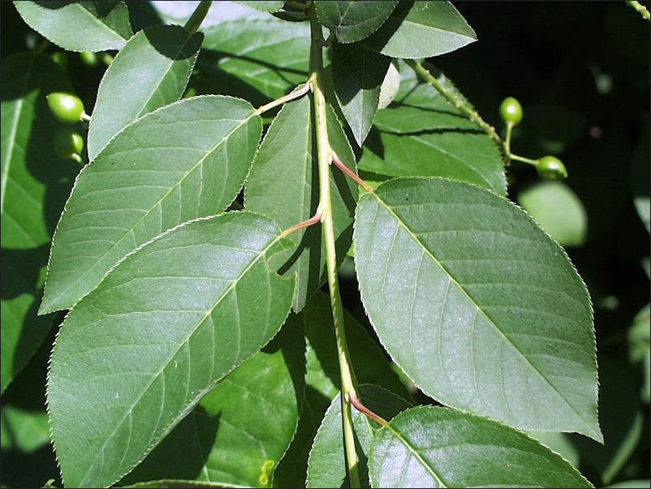
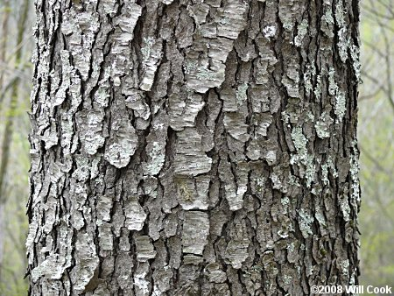

Slide 19
Black Cherry
Prunus Serotina

Slide 20
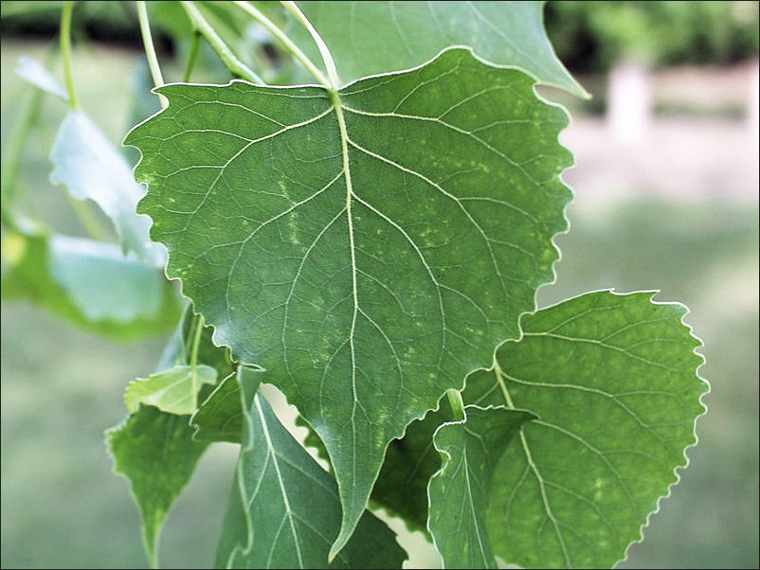

Slide 21
Eastern Cottonwood
Populus Deltoides

Slide 22
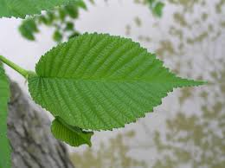
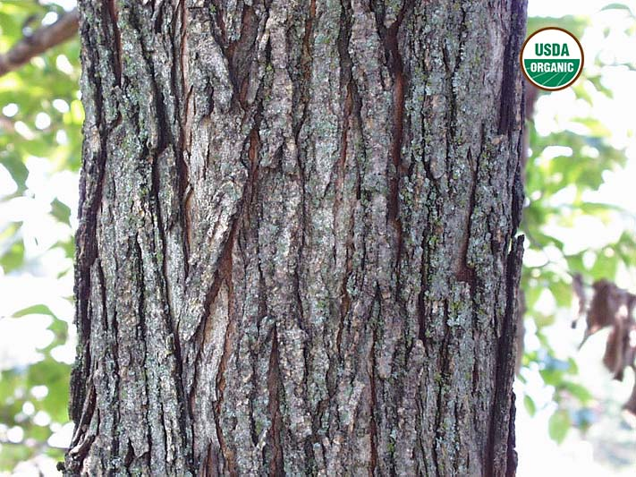

Slide 23
Elm
Ulmus sp.

Slide 24
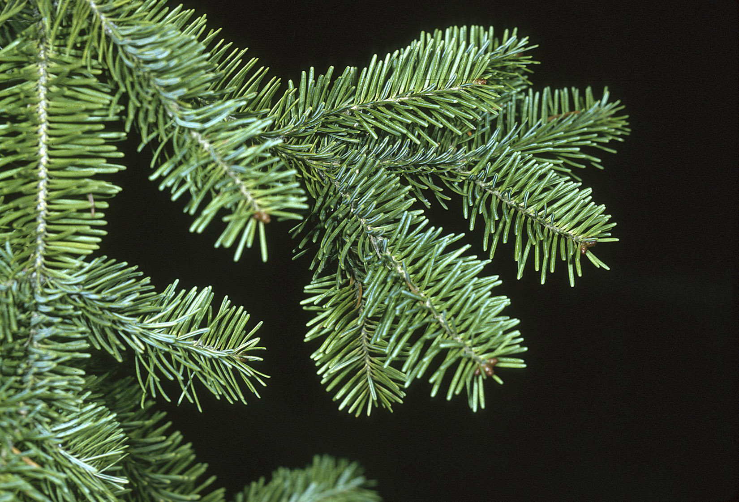
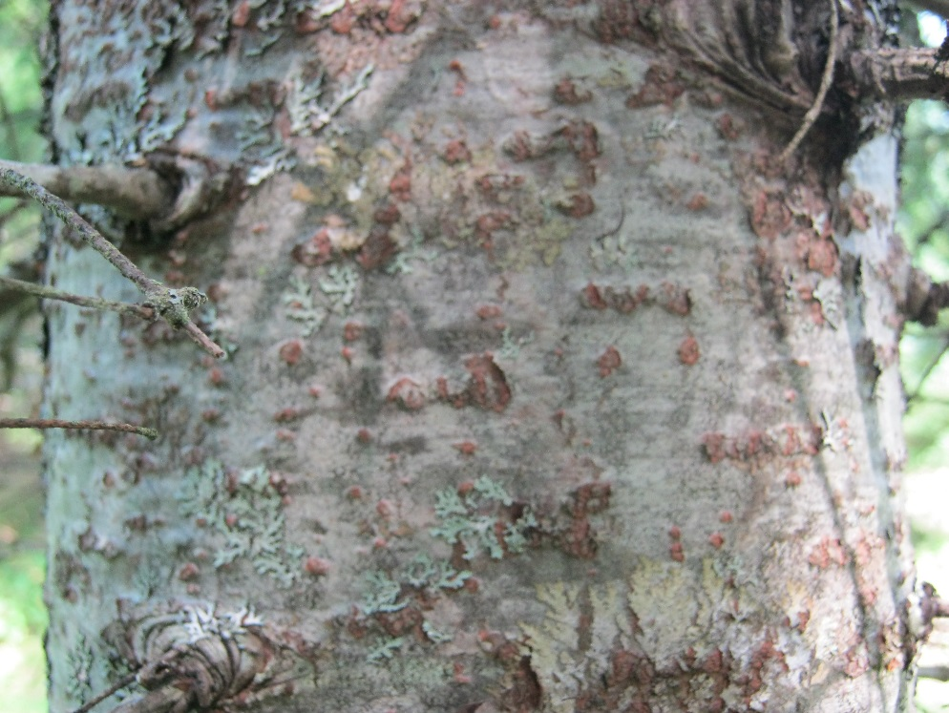

Slide 25
Balsam Fir
Abies Balasamea

Slide 26
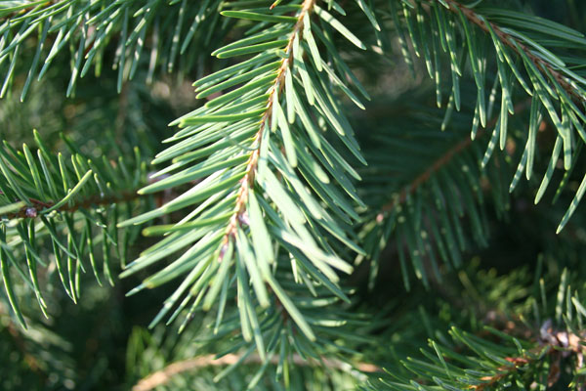
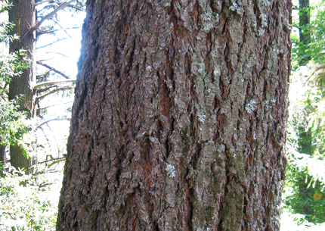

Slide 27
Douglas Fir
Pseudotsuga Menziesii

Slide 28
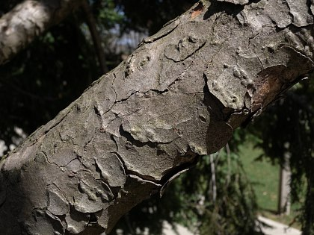
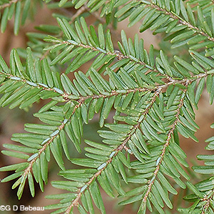
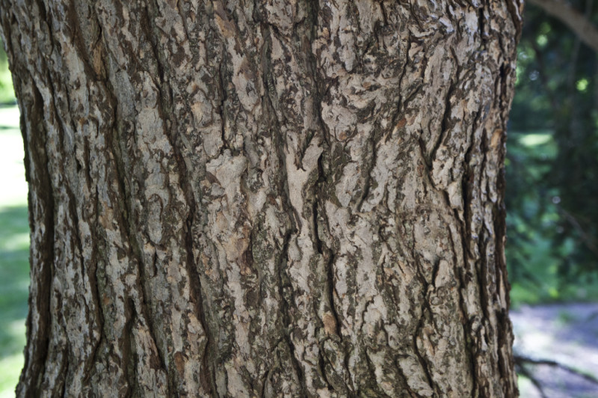

Slide 29
Eastern Hemlock
Tsuga Canadensis

Slide 30
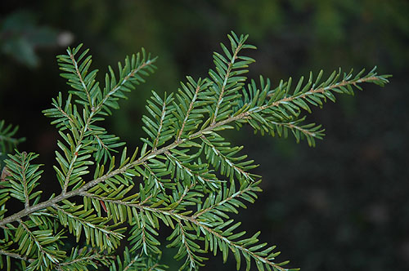
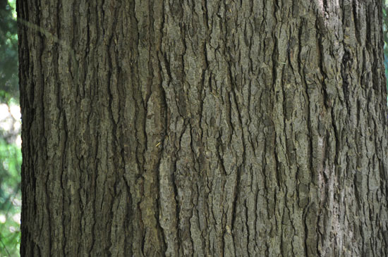

Slide 31
Western Hemlock
Tsuga Heterophylla

Slide 32
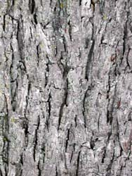
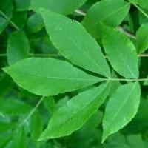

Slide 33
Hickory
Carya

Slide 34
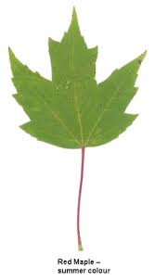
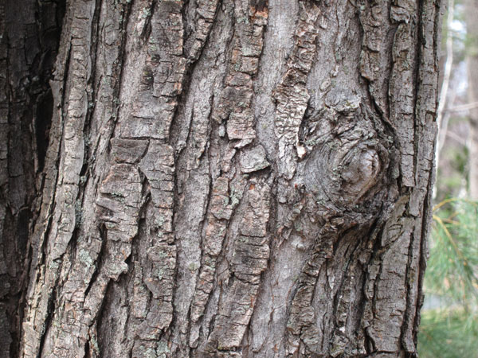

Slide 35
Red Maple
Acer Rubrum

Slide 36
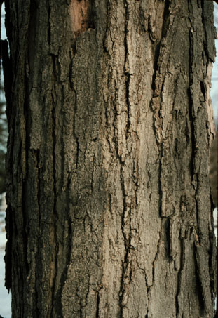
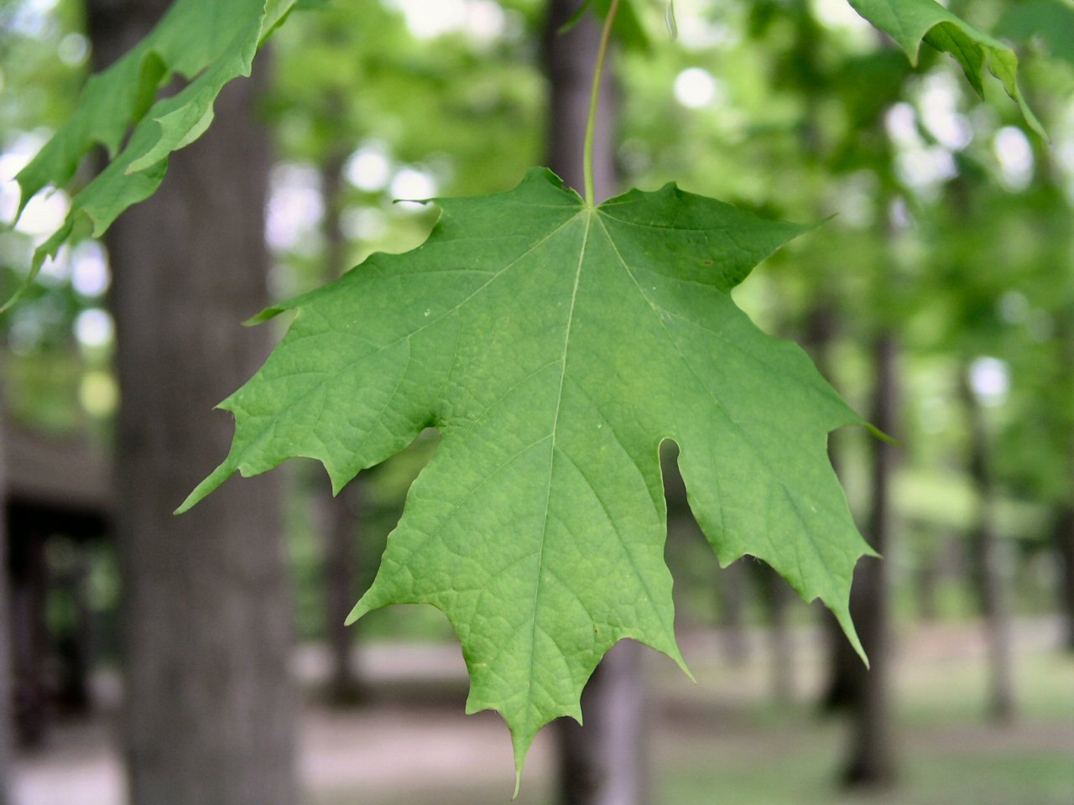

Slide 37
Sugar Maple
Acer Saccharum

Slide 38
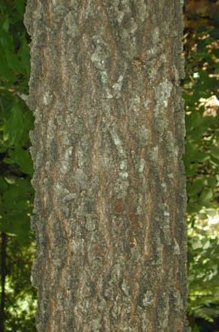
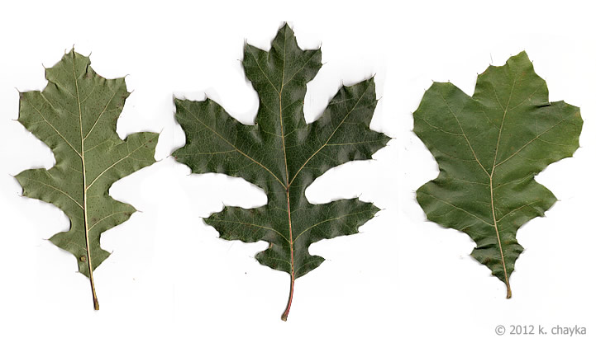

Slide 39
Black Oak
Quercus Velutna

Slide 40
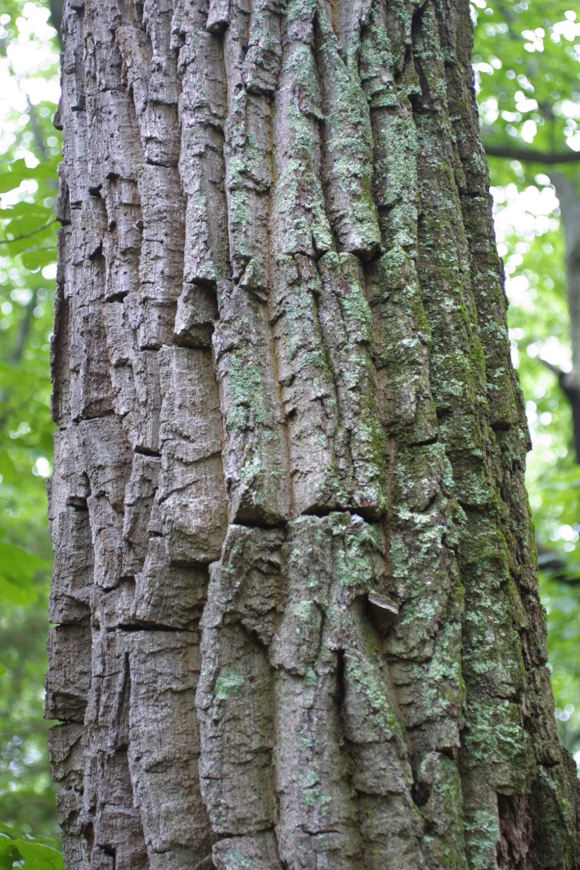
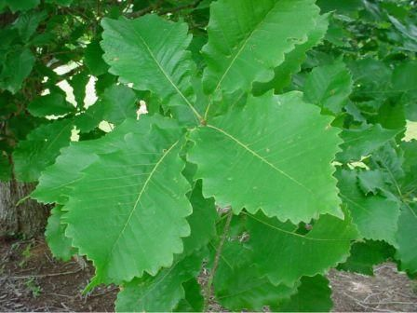

Slide 41
Chestnut Oak
Quercus Montana

Slide 42
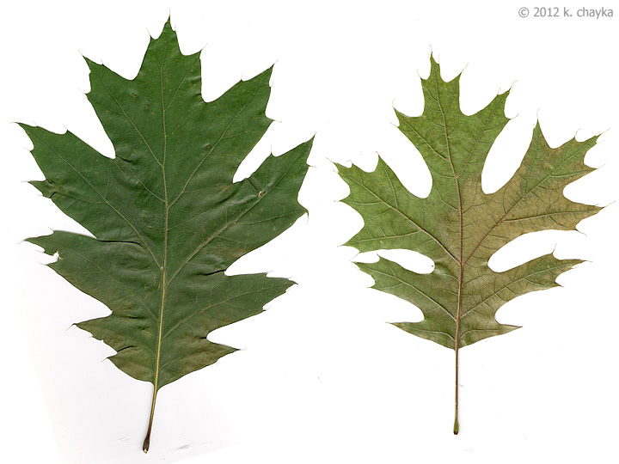
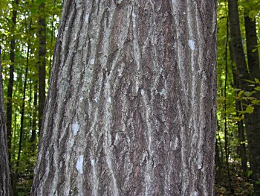

Slide 43
Northern Red Oak
Quercus Rubra

Slide 44
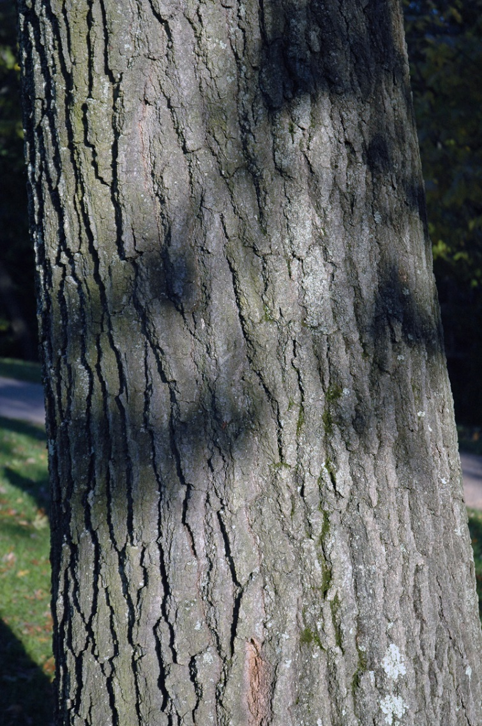
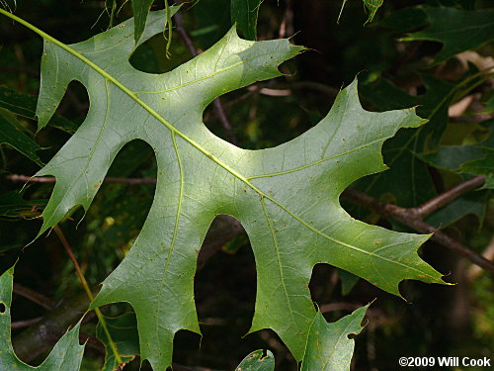

Slide 45
Scarlet Oak
Quercus Coccinea

Slide 46
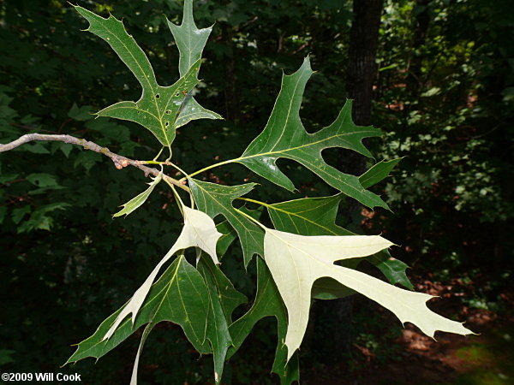
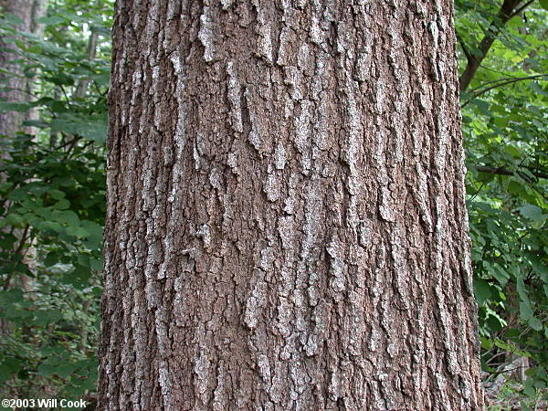

Slide 47
Southern Red Oak
Quercus Falcata

Slide 48
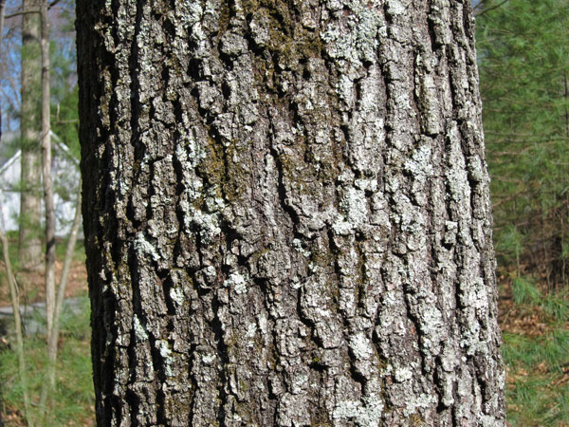
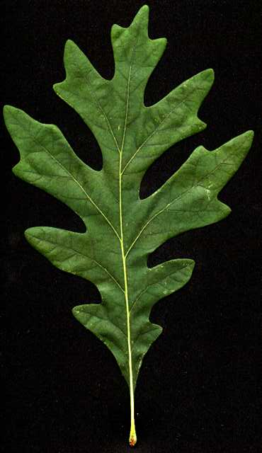

Slide 49
White Oak
Quercus Alba

Slide 50
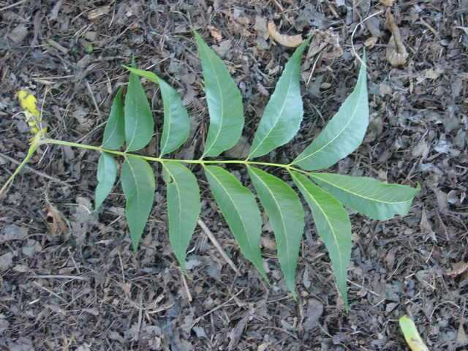
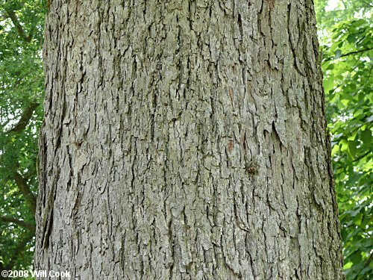

Slide 51
Pecan
Carya Illinoisnensis

Slide 52
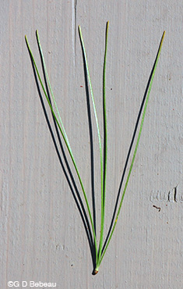

Slide 53
Eastern White Pine
Pinus Strobus

Slide 55
Loblolly Pine
Pinus Taeda

